Slide 1
An investment solution aiming at investing efficiently in US equities
Promotional INFORMATION
ODDO BHF US Equity Active UCITS ETF
September 2025

Slide 2
Disclaimer
ODDO BHF AM is the asset management division of the ODDO BHF Group. It is the common brand of three legally separate asset management companies: ODDO BHF AM SAS (France), ODDO BHF AM GmbH (Germany) and ODDO BHF AM Lux (Luxembourg). This document has been drawn up by ODDO BHF ASSET MANAGEMENT SAS. for market communication. Its communication to any investor is the exclusive responsibility of each distributor or advisor with the exception of Belgium, where this document is intended exclusively for distributors and may not be distributed to non-professional clients.
Potential investors should consult an investment advisor before subscribing to the fund. The investor is informed that the fund presents a risk of capital loss, but also many risks linked to the financial instruments/strategies in the portfolio. In case of subscription, investors must read the Key Information Document (KID) and the fund’s prospectus in order to acquaint themselves with the detailed nature of any risks incurred and all costs.
The value of the investment may vary both upwards and downwards and may not be returned in full. The investment must be made in accordance with investors’ investment objectives, their investment horizon and their capacity to deal with the risk arising from the transaction. ODDO BHF ASSET MANAGEMENT SAS cannot be held responsible for any direct or indirect damages resulting from the use of this document or the information contained in it. This information is provided for indicative purposes and may be modified at any moment without prior notice. Any opinions presented in this document result from our market forecasts on the publication date. They are subject to change according to market conditions and ODDO BHF ASSET MANAGEMENT SAS shall not in any case be held contractually liable for them.
The net asset values presented in this document are provided for indicative purposes only. Only the net asset value marked on the transaction statement and the securities account statement is authoritative. Subscriptions and redemptions of mutual funds are processed at an unknown asset value.
A summary of investor rights is available free of charge in electronic form in English language on the website at : https://am.oddobhf.com/FRANCE/en/non_professional_investor/infos_reglementaire
The fund may have been authorized for distribution in different EU member states. Investors are advised to the fact that the management company may decide to withdraw with the arrangements it has made for the distribution of the units of the fund in accordance with Article 93a of Directive 2009/65/EC and Article 32a of Directive 2011/61/EU.The complaints handling policy is available on our website am.oddo-bhf.com in the regulatory information section. Customer complaints can be addressed in the first instance to the following e-mail address: service_client@oddo-bhf.com (or directly to the Consumer Mediation Service: http://mediationconsommateur.be (ONLY FOR BELGIUM))
The Key Information Document (FR, DEU, ENG) and the prospectus (FR, DEU, ENG) are available free of charge from ODDO BHF ASSET MANAGEMENT SAS or at am.oddo-bhf.com or at authorized distributors. The annual and interim reports are available free of charge from ODDO BHF ASSET MANAGEMENT SAS or on its internet site am.oddo-bhf.com
The fund is licensed for sale in Switzerland. The Key Information Document, the prospectus, the annual and interim reports for Switzerland can be obtained free of charge from the Swiss Representative and paying agent, BNP Paribas Securities Services, succursale de Zurich, Selnaustrasse 16, 8002 Zurich, Switzerland
Risks
Equity risk, secondary market risk, concentration risk, emerging market risk, currency risk, risk related to ETF and non-ETF classes, environmental, social and governance standards, risk related to SFDR classification of sub-funds, selection risk, liquidity of investments, risk related to small and mid caps, political and/or legal/regulatory risk, regulatory restrictions and issuer-specific risk, risk related to the investment strategy, risk related to active management, risks related to the quantitative model
Countries in which the fund is authorized for distribution to the public: Ireland, Germany, France, Switzerland

Slide 3
Product
 | Inception date | Fund size | SFDR classification¹ | Risk scale²
ODDO BHF US Equity Active UCITS ETF | XX/08/2025 | 5 M€
6 | 8 | 9
4/7
Data as of 31/08/2025 | Source: ODDO BHF AM, ¹ The EU Sustainable Finance Disclosure Regulation (SFDR) is a set of EU rules which aim to make the sustainability profile of funds transparent, more comparable and better understood by end investors. Article 6: The management team does not consider sustainability risks or adverse effects of investment decisions on sustainability factors in the investment decision making process. Article 8: The management team addresses sustainability risks by integrating ESG criteria (Environment and/or Social and/or Governance) into its investment decision making process. Article 9: The management team follows a strict sustainable investment objective that significantly contributes to the challenges of the ecological transition, and addresses Sustainability Risks through ratings provided by the Management Company’s external ESG data provider. | ² The summary risk indicator (SRI) is a guide to the level of risk of this product compared to other products. It shows how likely it is that the product will lose money because of movements in the markets or because we are not able to pay you. It scales in a range from 1 (lowest risk) to 7 (highest risk). The lowest category does not mean a risk-free investment. This indicator is not constant and is updated if the risk profile of the fund changes over time. Historical data, such as is used to calculate the risk indicator, may not be a reliable indication of the future risk profile of the Fund. There is no guarantee that the management objectives in terms of risk will actually be met. The risk indicator assumes you keep the product until the end of the recommended holding period. The actual risk can vary ! significantly if you cash in at an early stage and you may get back less.

Slide 4




Overview
ODDO BHF US Equity Active UCITS ETF
Smart momentum investments in the us stock market
INVESTMENT STRATEGY summary
Why invest IN OUR FUND?
Profound economical basis: Studies have proved for various time periods that markets move in trends (momentum effect)
Utilizing a proprietary quantitative approach ODDO BHF US Equity Active UCITS ETF invests in US equities
The quantitative model rates equities based on a smart momentum strategy analysing extensive historical data with the aim to detect stable trends in the market
The portfolio construction process involves a strong focus on diversification and risk management by applying various constraints
Exploitation of stable market trends: A diversified approach to invest in different market trends with the objective of long-term outperformance utilizing proprietary quantitative models with no human biases.
Active ETF format: A cost-efficient and transparent way to benefit from our 20 years of experience with the same strategy in dedicated mandates, passing through various market cycles. The founders of the quantitative model in 2000 still manage the strategy today.*
The fund presents a risk of capital loss.
Source: ODDO BHF AM | *Current team, subject to change

Slide 5







Overview
Strategy and Team*
Dr. Stefan braun, CFA Global Head of Systematic Strategies ODDO BHF AM
25 years of investment experience
ODDO BHF “Algo Trend” strategies
Karsten seier, CFA Global Head of Systematic Strategies ODDO BHF AM
25 years of investment experience
Investment Conviction
Assets under Management ODDO BHF “Algo Trend” Strategy
Stock markets and stocks move in short to medium term trends
Behavioral Finance provides a convincing economical basis
Steffen Fuchs, CFA
Senior Portfolio Manager / Quantitative Analyst ODDO BHF AM
10 years of investment experience
Dr. Renata Latocha
Senior Quantitative Analyst ODDO BHF AM
23 years of investment experience
Investment Philosophy
€ 4.7 bn
Gundula Oehlke Quantitative Analyst ODDO BHF AM
34 years of investment experience
Exploiting the momentum effect with a purely quantitative concept for stock selection
Focus on portfolio construction and risk management
Thierry Misamer, CIIA, CEFA Senior Portfolio Manager ODDO BHF AM
26 years of investment experience
Thomas Höhenleiter, CIIA, CEFA Senior Portfolio Manager ODDO BHF AM
19 years of investment experience
Current team, subject to change. The strategy presents a risk of capital loss.
Source: ODDO BHF AM | Data as of 31/08/2025 | *Current team, subject to change

Slide 6
01 | What are active ETFs and why are they appealing?
02 | Why invest in the US Market?
03 | The case for momentum investments
04 | Investment process
05 | Portfolio

Slide 7
01
What are active ETFs and why are they appealing?

Slide 8

Overview
What are active ETFs?
An active investment strategy in an etf format
What are active ETFs?
The ETF itself is just a wrapper
An active ETF is an exchange-traded fund that is actively managed
When looking at ETFs it is important to note that terms like “passive”, “ETF” or “index” are not synonymous
A variety of strategies can be placed into the ETF structure to leverage its benefits, not just passive ones
Unlike passive ETFs which track a benchmark index, an active ETF seeks to outperform the benchmark.
Smart Beta
Active
Passive
Strategy is independent from the vehicle
ETF
Mutual Fund
Mandate
The fund presents a risk of capital loss.
Source: ODDO BHF AM, Company websites

Slide 9
Overview
Active ETF: A growing force in Europe
Although still much more established in the US, Active ETF are rapidly gaining momentum in Europe
Globally there are $1,100 billion in assets under management in active ETFs which account for 7% of total ETF AuM
The majority of assets, over $ 800bn are still held in active ETFs launched in the US, making up 8% of total US market
In Europe, active ETFs only make up 3% of the ETF market, but are one of the fastest-growing segments, appealing to institutional and retail investors.
$1 trillion
Expected AuM in Active ETF in Europe by 2030
Active ETFS AUM in Europe (€BN)
28%
of ETF AuM in Europe are expected to be actively managed by 2030
55
x5
33
24%
of professional investors in Europe and Asia already use active ETFs
21
23
13
94%
of wealth managers across Europe are planning to increase their use of active ETFs in 2025
The fund presents a risk of capital loss.
Source: ODDO BHF AM, Morningstar, Fidelity, Coalition Greenwich; Trackinsight Global ETF Survey 2024 | Data as of 31/12/2024 | *Current team, subject to change

Slide 10

Overview
Why invest in active ETFs?
The Benefits of the etf wrapper combined with the advantages of active investing
Outperformance POTENTIAL
Actively managed ETFs are based on in-depth research, leveraging on the skills of portfolio managers and offering the chance to outperform the market and generate alpha over the long run for their clients (risk of capital loss).
Transparency
Active ETF holdings are usually published daily on the provider’s website, allowing investors to know their exposure at any time.
Active
Management
ETF envelop
Benefits
Active ETFs
ACCESSIBILITY
ETFs are listed on stock exchanges like stocks and, in some cases, do not require a minimum investment amount.
Risk Management
Active strategies are able to react quickly to market changes and help manage risks more effectively.
Unconstrained
While passive funds just follow an index, active strategies are more flexible, allowing for avoiding overexposure to certain sectors or stocks.
Cost Efficiency
Active ETFs are designed to trade at prices that closely match the actual value of the fund’s holdings. They also typically have low management fees.
ESG
Active managers can align their portfolios more closely with ESG objectives by selecting investments that meet specific sustainability criteria, without the constraints imposed by index replication.
Flexibility
Active ETFs are traded on stock exchanges during market hours. Investors can buy or sell at any time throughout the trading day.
The funds present a risk of capital loss. Past performance is not a reliable indicator of future performance and is not constant over time.
Source: ODDO BHF AM, Company websites

Slide 11
02
Why invest in the US market?

Slide 12







Introduction
Why invest in the USA?
A leading Market that cannot be neglected
World’s largest economy
Industry diversity
Major Financial Market
The US economy is the largest worldwide with a GDP of 29 trillion $
Access to big success stories from both the new and old economy
Largest stock market in the world covering around 63% of the global market cap
Innovation Center
Sheer Size of the Country
Historically attractive
Home to many world-leading technology companies and innovative start-ups
With about 345 million people, the USA has the 3rd biggest population in the world and also ranks 3rd in terms of area
Since its inception in 1957, the S&P500 generated an average annual performance of 10.3 %
Past performance is not a reliable indicator of future performance and is not constant over time
Source: ODDO BHF AM, Bloomberg, Friedrich Ebert Foundation, IFO, IG, Federal Reserve, Investopedia,WIPO, IMF, MSCI | Data as of 2024
12

Slide 13














Introduction
Potential Global Champions from both the New and Old Economy
The best of both worlds according to our analysis
Magnificent 7
World-leading companies outside of tech
The 7 largest US Tech companies, which dominate the US stock market and the technology sector globally with their innovation leadership and impact on technological advancement
Many examples of successful companies from various industries showing the diversity of potentially interesting companies to be found in the US market
These examples are no investment recommendations
Source: ODDO BHF AM, Company websites

Slide 14
Introduction
The World’s most important Financial Market
attractive historical performance compared to other regions
CUMULATIVE PERFORMANCE
ANNUALIZED PERFORMANCE IN %
Past performance is not a reliable indicator of future performance and is not constant over time
Source: ODDO BHF AM, Bloomberg | Data as of 30/06/2025

Slide 15
03
The case for momentum investments

Slide 16


The case for momentum investments
Are stock markets efficient?
The Efficient market hypothesis
Various forms of market efficiency
The efficient-market hypothesis states that asset prices reflect currently available information
Weak form: Current asset prices reflect all information contained in historical prices
Semi-strong form: Asset prices reflect all public information
Strong-form: Asset prices reflect all public and private information
Fama 1970
“Efficient Capital Markets: a Review of Theory and Empirical Work”
Past performance is not a reliable indicator of future performance and is not constant over time
Source: ODDO BHF AM

Slide 17
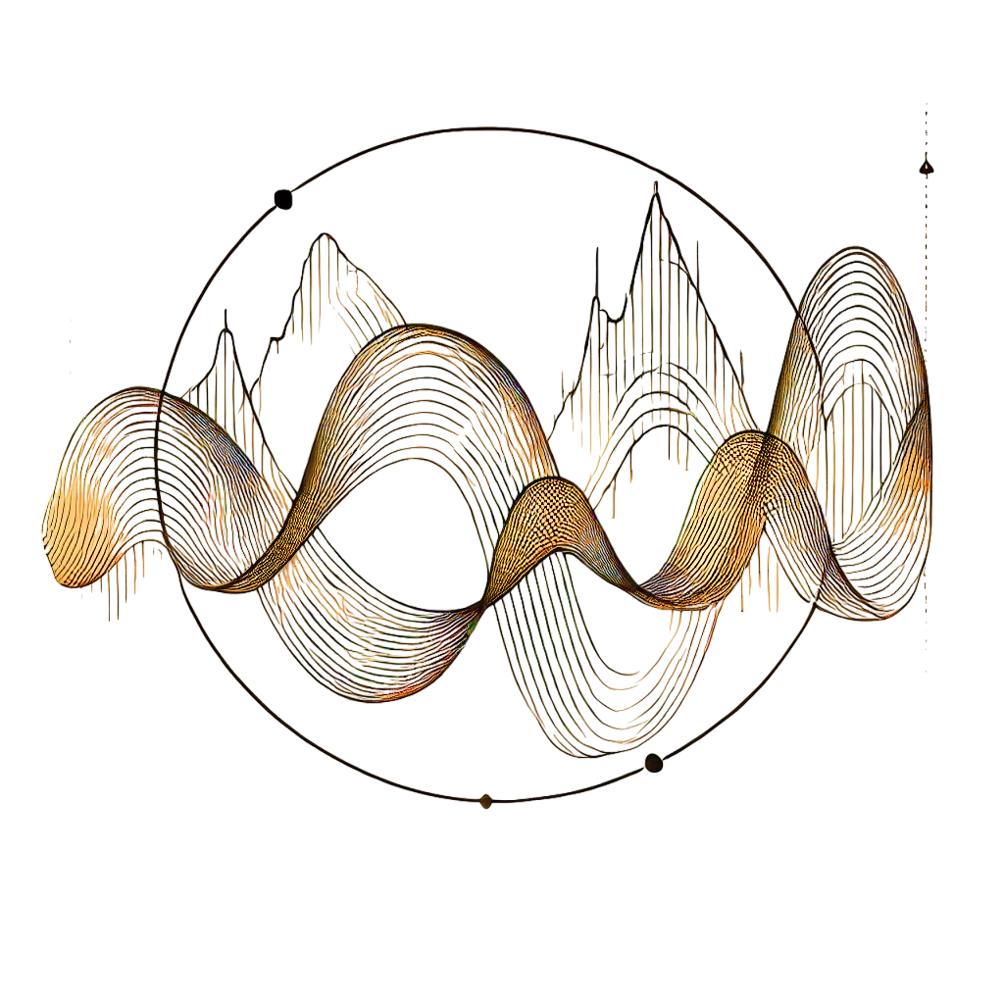

The case for momentum investments
The Momentum Effect
Stock markets move in short- to medium-term trends
momentum historically outperformed the broad market and other Factors in the us¹
What is The momentum effect?
Stock Market “Anomaly”
Academically well researched
Persists in various markets and for different time periods
Continuation of Returns
Stocks that outperformed in the past tend to outperform in the following period
Vice versa, stocks with poor past performance, tend to continue underperforming
Past performance is not a reliable indicator of future performance and is not constant over time
Source: Bloomberg, ODDO BHF AM | ¹ Net Return in USD as of 31/08/2025

Slide 18




The case for momentum investments
Behavioral Finance provides theories
To explain irrational investor behavior
Behavioral Biases of investors lead to overreaction/underreaction to news
Anchoring
Overconvidence
Herding
… and many more
Source: ODDO BHF AM

Slide 19
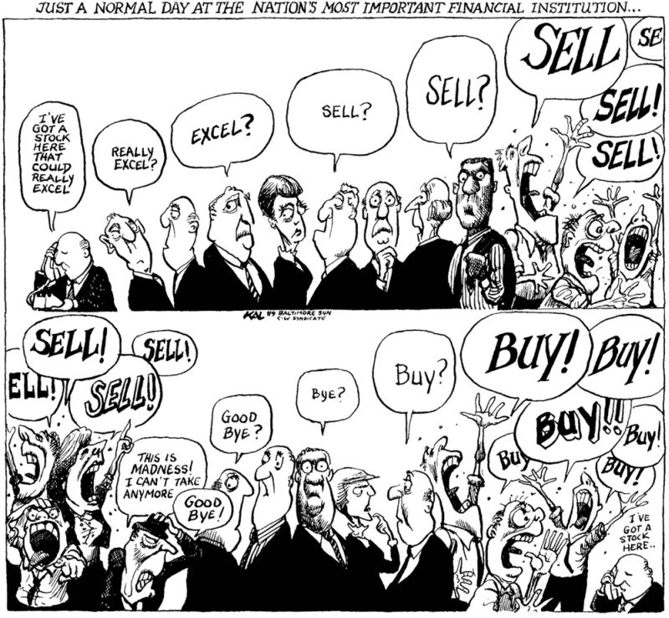
The case for momentum investments
Behavioral Finance Explanations for the Momentum Effect
irrational investors and cognitive biases
Herding and Fear of Missing Out
Overconfidence
Over- and Underreaction
Most people think they are above average, despite it is mathematically impossible…
Fair stock price before and after new information becomes available
Actual stock price
100 people were interviewed…
Are you an above-average driver?
Are you above-average intelligent?
Are you an above-average investor?
Past performance is not a reliable indication of future return and is not constant over time.
Source: ODDO BHF AM, DeBondt and Thaler 1985, Jegadesh and Titman 1993, Kal’s Cartoon, Ola Svenson 1981, Ethan Zell 2020 | Data as of 31/10/2024

Slide 20
The case for momentum investments
Understanding the Risks of Momentum Investing
Management of trend reversal risk
Pro-cyclical beta exposure
Concentration risk
Naïve momentum strategies select stocks which performed well in the past resulting in a high beta portfolio following a market rally and low beta in down-markets
Trends are likely to end and reverse at a certain point: Risk of large losses when markets correct/rebounds
Naïve momentum strategies imply high concentration risk and high tracking error
Example: Sector allocation of a S&P500 naïve momentum strategy* during sector rotation 2022-2024
Index Performance
The fund presents a risk of capital loss.
Source: ODDO BHF AM, Datastream | *Long only Investment in top 10% stocks based on 1Y Performance

Slide 21

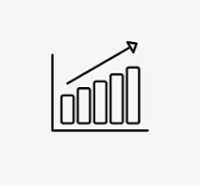

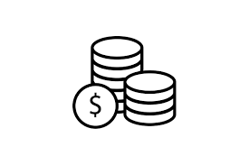


The case for momentum investments
Key Takeaways
According to our analysis
Stock markets move in short to medium term trends
Reason: Irrational investor behavior and cognitive biases
Momentum effect can be exploited via a trend following investment approach offering high outperformance potential in the long term
Momentum effect is persistent and cannot be arbitraged away
Momentum has specific risks that need to be understood and managed
The fund presents a risk of capital loss.
Source: ODDO BHF AM

Slide 22
04
Investment Process

Slide 23


Investment Process
„Algo Trend“ Investment Process Overview
systematic and transparent – no “black box”!
Step 1: Identification of high-quality Trends
Step 2: Construction of a diversified Momentum Portfolio
Result: Final Portfolio
Long-term outperformers
Short-term trend intact
Preference for low volatility
Portfolio optimization
Build a high momentum portfolio respecting strict risk management constraints
Broadly diversified and risk-controlled portfolio
Numerous positions covering many trends
Monthly rebalancing
Expected Active Return
Risk
The fund presents a risk of capital loss.
Source: ODDO BHF AM

Slide 24

Investment Process
Step 1: Identification of high-quality Trends
Assigning a Trend Score to all Companies
Long-term outperformers (65% of final trend score)
Short-term outperformers (35% of final trend score)
Ranking including a penalty for volatility
Company | Short-term active return | Long-term active return | Volatilty | Final Trend Score
A | 14,3% | 18,6% | 30,1% | 56,79
B | 12,9% | 13,6% | 23,7% | 56,35
C | 18,3% | 16,7% | 30,9% | 55,86
… | … | … | … | …
+
Benchmark
Benchmark
3 years Timeline (150 weeks)
9 monthsTimeline (40 weeks)
Past performance is not a reliable indication of future return and is not constant over time. The simulation presented does not constitute a forecast of the future performance of your investments. It is solely designed to illustrate the mechanisms of your investment over the investment period. The value of your investment may deviate upwards or downwards from what is displayed.
Source: ODDO BHF AM, Datastream

Slide 25

Investment Process
Step 2: Portfolio Construction
Building a Broadly diversified and risk-controlled momentum portfolio
Quantitative Portfolio Optimization
Company | Final Trend Score
A | 56,79
B | 56,35
C | 55,86
… | …
Country &
Sector
Beta
Tracking
Error
Turnover
Construct the portfolio with the highest possible Final Trend Score while respecting strict risk management constraints
The fund presents a risk of capital loss. Past performance is not a reliable indication of future return and is not constant over time. The simulation presented does not constitute a forecast of the future performance of your investments. It is solely designed to illustrate the mechanisms of your investment over the investment period. The value of your investment may deviate upwards or downwards from what is displayed.
Source: ODDO BHF AM

Slide 26


Investment process
Example of Portfolio Implementation: Iron Mountain Inc
momentum score and relative weight over time
2
Following a postive long-term outperformance of the stock, the trend score and the overweight increase
1
Relative underperformance and increased volatility in the beginning lead to a weak trend score and a slight underweight of the stock in the portfolio
Past performance is not a reliable indication of future return and is not constant over time. This example is not an investment recommendation.
Source: ODDO BHF AM, Datastream | Benchmark: S&P 500 | Data as of 31/10/2024

Slide 27
05
Portfolio

Slide 28
Portfolio
Sector Allocation
Relative sector weights (in %)
Absolute sector weights (in %)
These examples are no investment recommendations
Source: ODDO BHF AM | Data as of 30/06/2025 | Benchmark: S&P 500 NR

Slide 29
Portfolio
Largest Positions in the Portfolio
Top 10 Holdings
 | FUND (%) | Benchmark (%) | Country | Sector
NVIDIA CORP | 8,0% | 7,3% | USA | Semiconductors & Semiconductor Equipment
MICROSOFT CORP | 6,1% | 7,0% | USA | Software & Services
APPLE INC | 5,2% | 5,9% | USA | Technology Hardware & Equipment
META PLATFORMS INC | 3,1% | 3,1% | USA | Media & Entertainment
BROADCOM INC | 3,1% | 2,5% | USA | Semiconductors & Semiconductor Equipment
BOSTON SCIENTIFIC CORP | 2,9% | 0,3% | USA | Health Care Equipment & Services
JPMORGAN CHASE & CO | 2,6% | 1,5% | USA | Banks
NETFLIX INC | 2,5% | 1,1% | USA | Media & Entertainment
AMAZON.COM INC | 2,4% | 3,9% | USA | Consumer Discretionary Distribution & Retail
WALMART INC | 2,4% | 0,8% | USA | Consumer Staples Distribution & Retail
These examples are no investment recommendations
Source: ODDO BHF AM | Data as of 30/06/2025 | Benchmark: S&P 500 NR

Slide 30
Portfolio
Largest Over- and Underweights
Top 10 relative Weights
Bottom 10 relative Weights
These examples are no investment recommendations
Source: ODDO BHF AM | Data as of 30/06/2025 | Benchmark: S&P 500 NR

Slide 31
Details
Fund Characteristics
Countries available for Sales | Ireland, France, Germany, Switzerland
General characteristics
Fund name | ODDO BHF US Equity Active UCITS ETF
Benchmark | S&P 500 USD Net Total
Investment objective | The investment objective is to achieve long-term capital growth by investing in a portfolio of US equity securities.
Inception date | 2025
Recommended investment horizon | 5 years
ISIN code | IE000YR7N5U8
Stock Exchanges | Xetra, Euronext Paris and Dublin, SIX
Tickers | OBUS, Xetra: ODUS
Currency | USD
Dividend policy | Accumulation
TER | 0,35%
Minimum Initial Investment Amount | None
Structure and technical information
Domicile | Ireland
Management company | HANetf Management Limited
Legal structure | Sub-fund of the HANetf ICAV 1
Investment Manager by delegation | ODDO BHF Asset Management GmbH (sub-delegation from ODDO BHF Asset Management SAS )
Custodian | JP Morgan, Dublin Branch
Primary Market Parameters
Creation Unit | 100,000 shares
Initial Offering Price | $10
Dealing Day | Each Business Day (with exceptions)
Dealing Deadline | 3:30 p.m. (Irish time) on Business day
Settlement Date Subscriptions | T+1 (cash) for subscriptions and T+2 (max T+10) for redemptions
Source: ODDO BHF AM

Slide 32
GLOSSARY OF TERMS (1/2)
Performance calculation
The funds’ cumulative performances are calculated with dividends reinvested. Annualised performance is calculated on an actuarial basis on an annual basis over 365 days. Differences in the performance of a fund relative to its benchmark are arithmetic differences. Statistical indicators are generally calculated on a weekly basis on Fridays, or the previous valuation day failing that.
Active Share
Measure of the percentage of securities in the portfolio that differs from the benchmark. A higher active share implies a greater difference in portfolio allocation vs the benchmark.
Jensen’s alpha
Measure of the performance gap between the portfolio and the benchmark with a similar level of risk (adjusted for β). It measures the value of the fund or the manager’s ability to “beat the market”, also known as excess return.
Beta
β measures the sensitivity of the performance of a portfolio compared with that of its benchmark, i.e., when the bench- mark varies by X%, the fund varies, on average, by a magnitude equal to β*X%.
Correlation coefficient
The correlation coefficient defines the degree of dependence between change in the performance of the portfolio and that of its benchmark. The closer it is to 1, the greater the degree of dependence. A negative correlation coefficient means that, on average, the portfolio will fluctuate inversely to its benchmark.
Duration
Duration is a measure of interest rate risk in bond instruments. Duration is expressed as the weighted average life of all flows (interest and principal).
Distance to bond floor
For convertible bonds, the value of the bond component. The distance to the bond floor represents the value of the conversion option into shares.
Maximum Drawdown
The maximum drawdown is the level of loss (in %) recorded on a fund during the worst period of decline over the period under review.
Average maturity
Average life is defined as the weighted average maturity (in years) of all the cash flows (including repayment of the of capital) resulting from an investment. Therefore, it is a question a measuring instrument allowing to assess the sensitivity of the price of an asset or a portfolio at a change in interest rates.
Sharpe Ratio
The Sharpe ratio measures the risk/return profile of the portfolio or benchmark. It is the difference between the annualised performance of the fund (or its benchmark) and the annual return based on the risk-free rate divided by the volatility of the fund (or its benchmark).
Information ratio
The information ratio measures the over/under performance achieved by the manager when he or she deviates from the reference indicator It is equal to the difference in the annualized portfolio return by relative to its reference indicator, divided by the tracking error.
Recovery Delay
Payback period of maximum drawdown: the time to clear the loss on the worst period of decline and return to the original level.

Slide 33
GlossarY of Terms (2/2)
Yield to maturity
The yield to maturity of a bond is the real rate of return on the bond for an investor who keeps it until its redemption, assuming that the issuer will not default and assuming the reinvestment of interest at the same yield.
Equity sensitivity
For convertible bonds, equity sensitivity measures the percentage change in value induced by a change in the equity markets.
Credit sensitivity
Credit sensitivity is used to measure the risk associated with changes in credit spreads. The value of the portfolio is subject to change in the event of deterioration or improvement in the quality of issuers. Thus, a value of +2% for instance means that for an instantaneous 1% increase (respectively decrease) in spreads, the portfolio value would decrease (in- crease) by 2%.
Interest rate sensitivity
For convertible bonds, interest rate sensitivity measures the percentage change in value induced by a change in the interest rate.
Credit spread
The credit spread refers to the risk premium, or the difference between the yields on corporate bonds and government bonds with similar characteristics.
Turnover rate
The portfolio turnover rate is the sum of movements (purchases and sales of securities), less the amount of subscriptions/redemptions, based on the average net assets observed over the period.
Tracking-Error
Measure of the relative risk taken by a fund vs its benchmark. The tracking error is the volatility of relative performance, i.e. the annualised standard deviation of the arithmetic over- or underperformance of the portfolio vs its benchmark.
Weighted Average Life (WAL)
For money market funds: weighted average life of the portfolio until the date of termination of financial instruments.
Weighted Average Maturity (WAM)
Weighted average maturity of the portfolio: measure of sensitivity of money market funds to interest rate risk.
Ex-post Value at Risk (VaR)
Ex-post VaR is the maximum loss recorded by an investor factoring in an investment period and a confidence interval. Thus, a daily 1-year VaR of x% calculated with a confidence interval of 99% means that, over an observation period of 1 year, only 1% of daily performances were below x%.
Volatility
Volatility is a risk indicator that measures the magnitude of the variation of a portfolio (or benchmark) over a given period. It is calculated as the annualised standard deviation of absolute returns over a defined period.

Slide 34
Important Information
If ODDO BHF Asset Management GmbH receives any rebates on the management fee of target funds or other assets, ODDO BHF Asset Management GmbH undertakes to fully remit such payment to the investor or the fund. If ODDO BHF Asset Management GmbH performs services for an investment product of a third party, ODDO BHF Asset Management GmbH will be compensated by the relevant company. Typical services are investment management or sales activities for funds established by a different investment management company. Normally, such compensation is calculated as a percentage of the management fee (up to 100%) of the respective fund, calculated on the basis of such fund’s assets managed or distributed by ODDO BHF Asset Management GmbH. This may result in the risk that the investment advice given may not be consistent with the investor’s interest. The amount of the management fee is published in the prospectus of the respective fund. Further details are available upon request. It is further intended solely for persons based in countries in which the respective funds are registered for distribution or in which such registration is not required. The shares of the fund have not been registered under the United States Securities Act of 1933, as amended (the “1933 Act”); they may therefore not be publicly offered or sold in the United States of America or to US citizens or any US residents. This publication is intended as marketing instrument and does not satisfy the statutory requirements regarding the impartiality of a financial analysis, and the financial instruments concerned are not subject to any prohibition of trading in advance of the publication of this presentation.
Copyright © Morningstar, Inc. All Rights Reserved. The information, data, analyses and opinions with reference to Morningstar contained herein (1) include the confidential and proprietary information of Morningstar, (2) may not be copied or redistributed, (3) do not constitute investment advice offered by Morningstar, (4) are provided solely for informational purposes and therefore are not an offer to buy or sell a security, and (5) are not warranted to be correct, complete or accurate. Except as otherwise required by law, Morningstar shall not be responsible for any trading decisions, damages or other losses resulting from, or related to, this information, data, analyses or opinions or their use. This report is supplemental sales literature, and therefore must be preceded or accompanied by a prospectus and disclosure statement. STOXX Limited (“STOXX”) is the source of
Any aforementioned STOXX index and the data comprised therein. STOXX has not been involved in any way in the creation of any reported information and does neither warrant nor assume any liability whatsoever – including without limitation the accuracy, adequateness, correctness, completeness, timeliness, and fitness for any purpose – with respect to any reported information. Any dissemination or further distribution of any such information pertaining to STOXX is prohibited.
The European Directive 2014/65/EU (the so-called "MiFID II Directive") extends the scope of provisions requiring that investor information be fair, clear and not misleading, making them applicable also for professional clients. Article 44 of such Directive provides that the information be sufficient for, and presented in a way that it is likely to be understood by, the average member of the group to whom it is directed, or by whom it is likely to be received, and that the information does not disguise, diminish or obscure important items, statements or warnings. We have presented the performance shown in this document in a manner that we deem appropriate for the target audience of this document. Further information on the performance presented in this document is available on request.
.
Strictly confidential
12.09.2025

